Slide 1


CYBER CAPITAL
Deriving insight on the use of space from the digital layer of cities and territories for location intelligence
22th april 2021
Babini Teresa, Lombardi Filippo, Rossetti Pietro, Rota Francesca

Slide 2
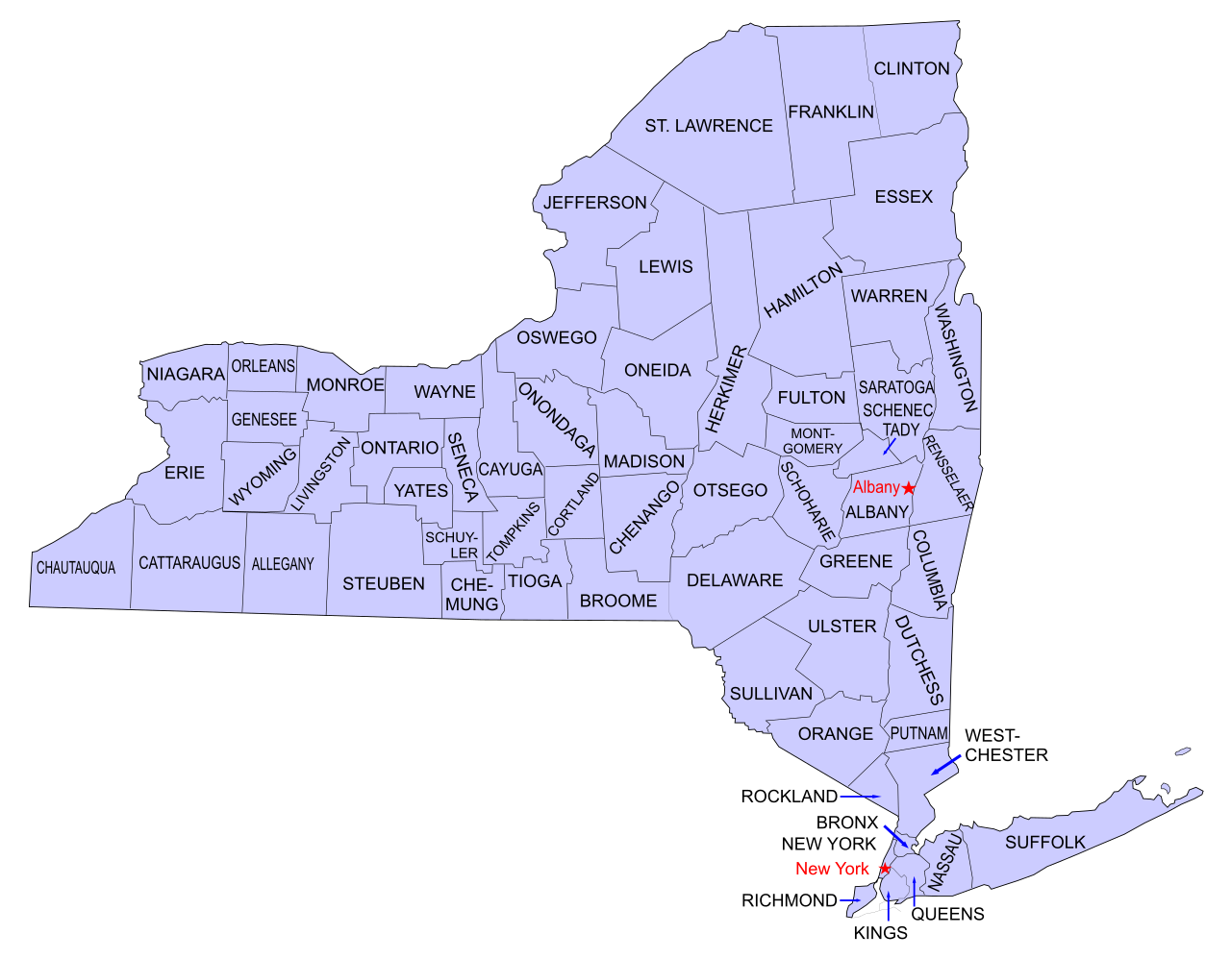
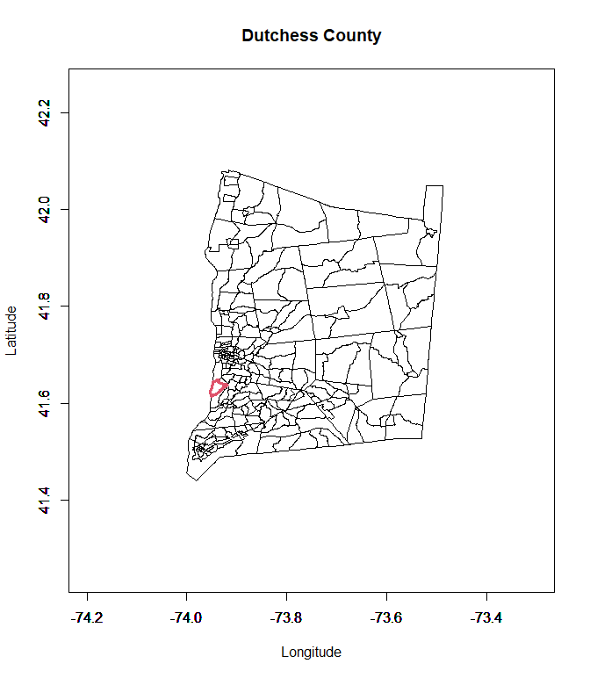
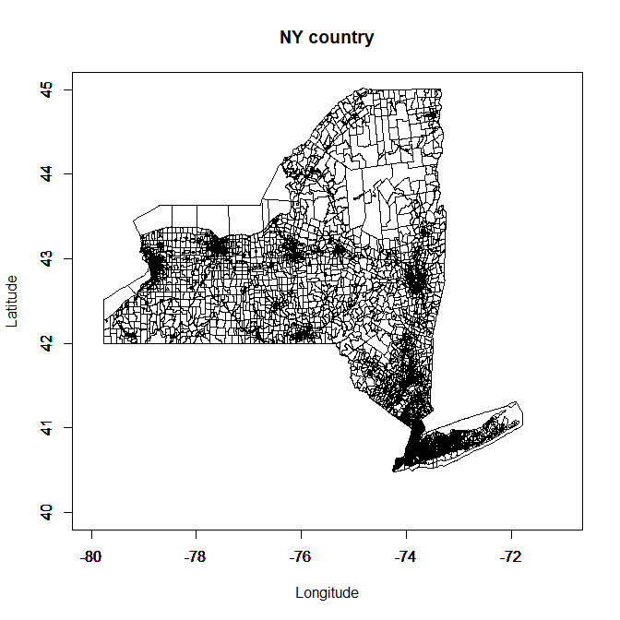
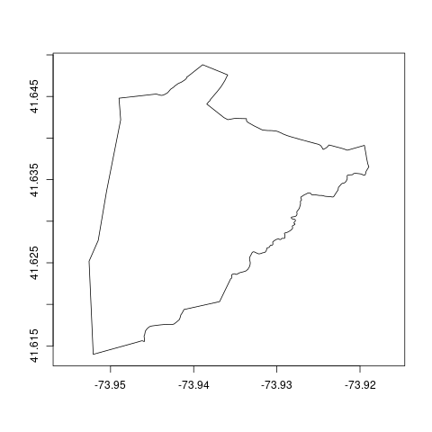
INTRODUCTION
Patterns of the country of NY
CBG = Census Block Group (n = 15461)
census_blocks_ny
Notes:
topic: new york state, CBG division (we delete 15 rows since data were incomplete → lots of NA value)

Slide 3
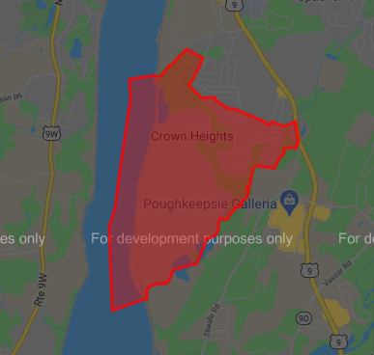
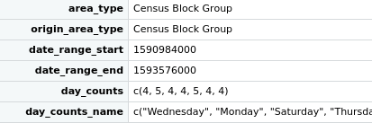


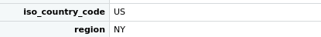
DATASET
#CBGSs = 15446
#features = 35 in Patterns_NY
census_blocks_ny
patterns_NY
Notes:
Foot-traffic insights for places derived from anonymized mobile devices.
explain the main features that are in the photo : qua ho messo le coordinate (per far vedere che abbiamo info anche da census_blocks_ny, magari accennare quali) poi quelle features lì di Patterns NY sono uguali per tutti inutili -> common features

Slide 4
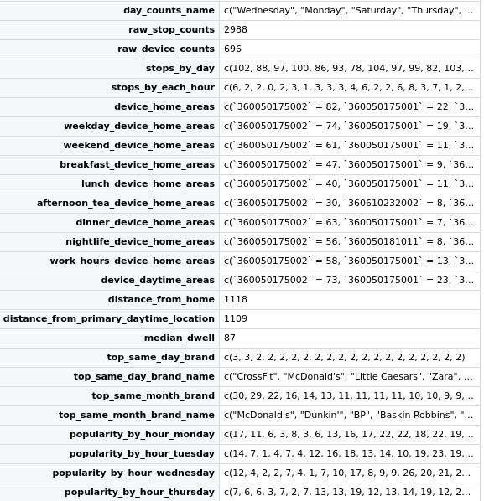
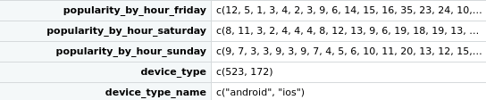
median_dwell
Notes:
Foot-traffic insights for places derived from anonymized mobile devices.
explain the main features that are in the photo:

Slide 5
Notes:
Foot-traffic insights for places derived from anonymized mobile devices.
explain the main features that are in the photo:

Slide 6

AIMS
Describe how devices move within and around CBGs
which are the busiest days
pole of attraction -> cluster into cities and countryside
Prediction of time of stay in a CBG for suitable allocation of services
Do cities have an higher time of stay than countrysides?
Location intelligence of new brands
Notes:
“using anonymized and aggregated location data to understand how devices move within and around CBGs can help businesses, researchers, and local governments better assess existing foot traffic trends and predict future consumer movement patterns”
dopo ridge regression: parliamo di classificazione e clustering -> sulle marche? / bisogna capire come sfruttare quei dati. suddividere i brand legati ad ambiti diversi. dividere i brand che abbiamo in classi, capire come interpretare qst dato. sai che in quella zona lì c’è o meno bisogno di una classe di brand(o di un brand specifico)
su qst, occhio alla vicinanza tra i blocchi
cluster: raggruppi i cbg come densità popolazione, periferia o no -> magari per trovare un threshold della densità per capire cosa è città e cosa no (di per sè inutile .. però vd mail izzo)

Slide 7
FIRST LOOK: ANOVA
Notes:
qua forse metterei un grafico (se mi riesce) che dia l’idea dei flussi a partire da esempio feature weekday_device_home_areas

Slide 8
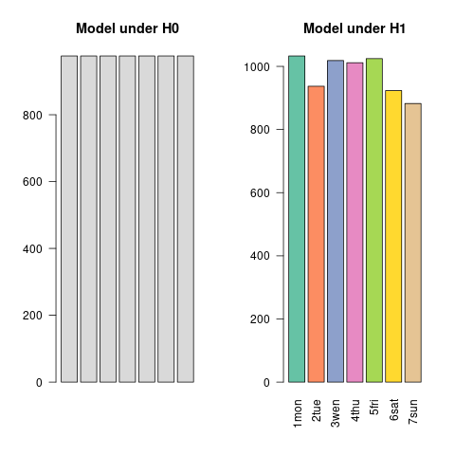
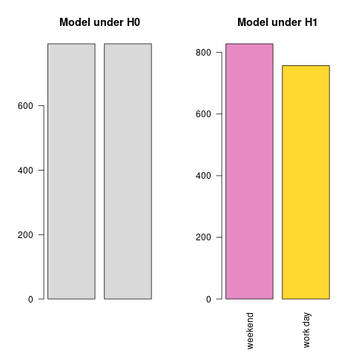


ONE-WAY ANOVA
variable : mean density of stops [1/km²]
factor → week day
variable : mean density of stops[1/km² ]
factor → {weekend, work day}
Notes:
sto solo cercando di farvi un recap, non è chiaramente come lo metterei
PER I COLORI DITEMI SE NON VI PIACCIONO, NE HO TROVATI TOT E DOVREI AVER CAPITO COME FARE, ALTRIMENTI SONO IN GRADO DI METTERMI A SCEGLIERLI UNO AD UNO EH EH
(colori ok per la frarota da bressobeach)

Slide 9
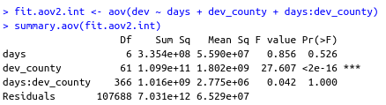
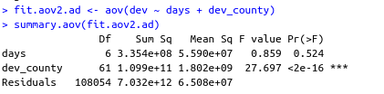
TWO-WAYS ANOVA
Variables : mean density of stops[1/km² ]
factor 1 → week day
factor 2 → county
Model with interaction
Additive model
Notes:
sto solo cercando di farvi un recap, non è chiaramente come lo metterei

Slide 10

NY

Slide 11
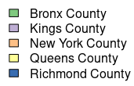
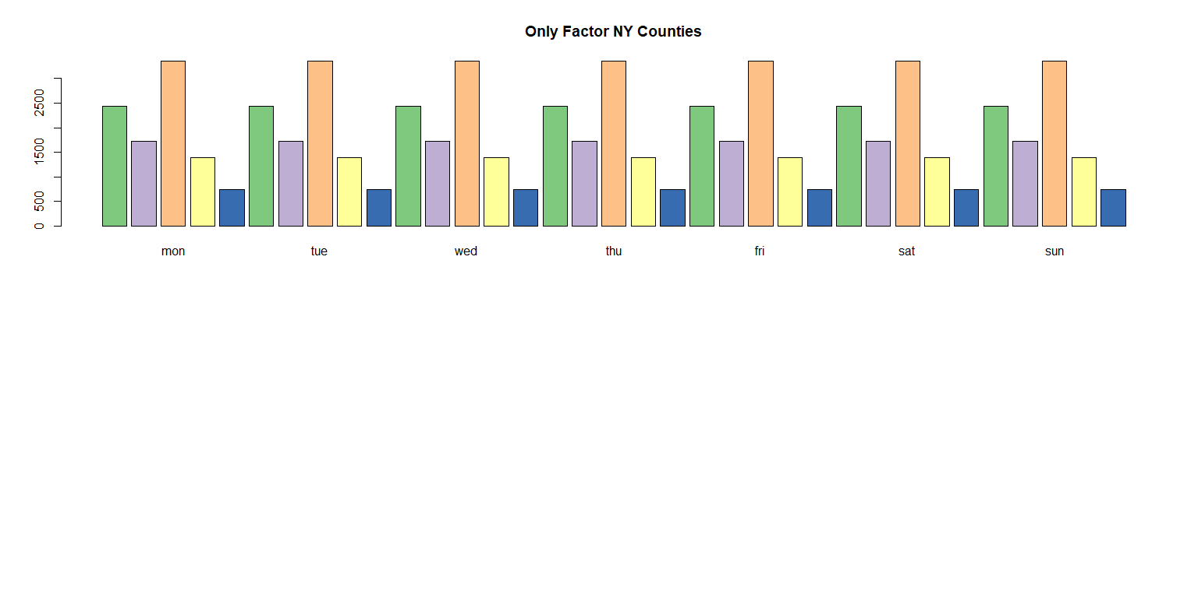
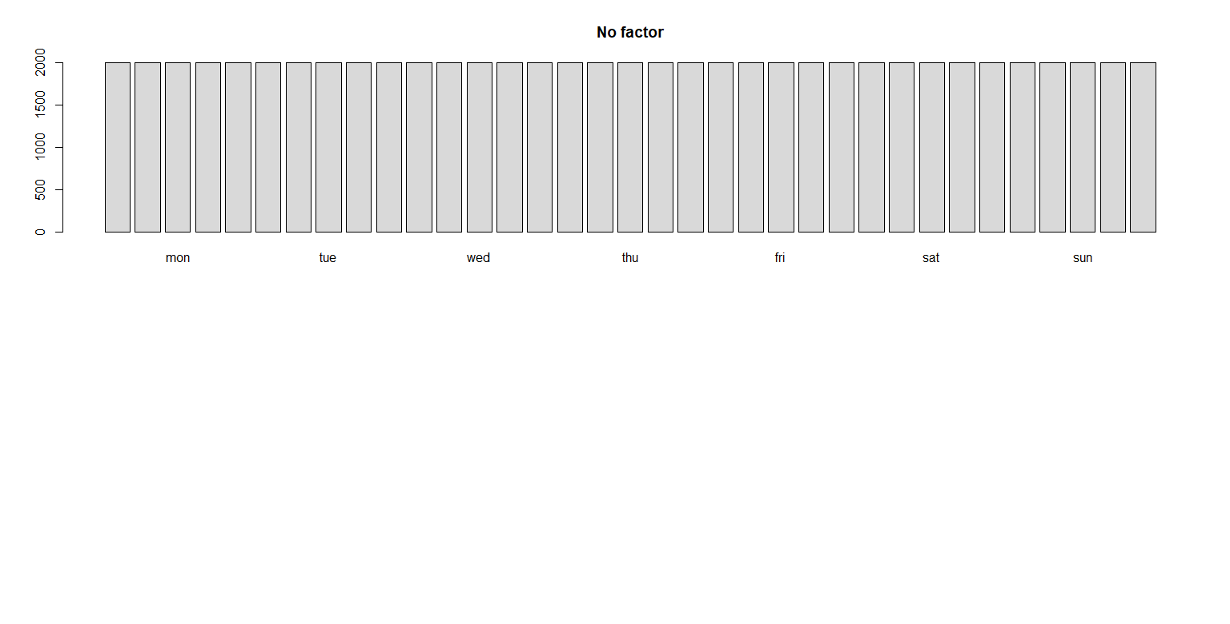
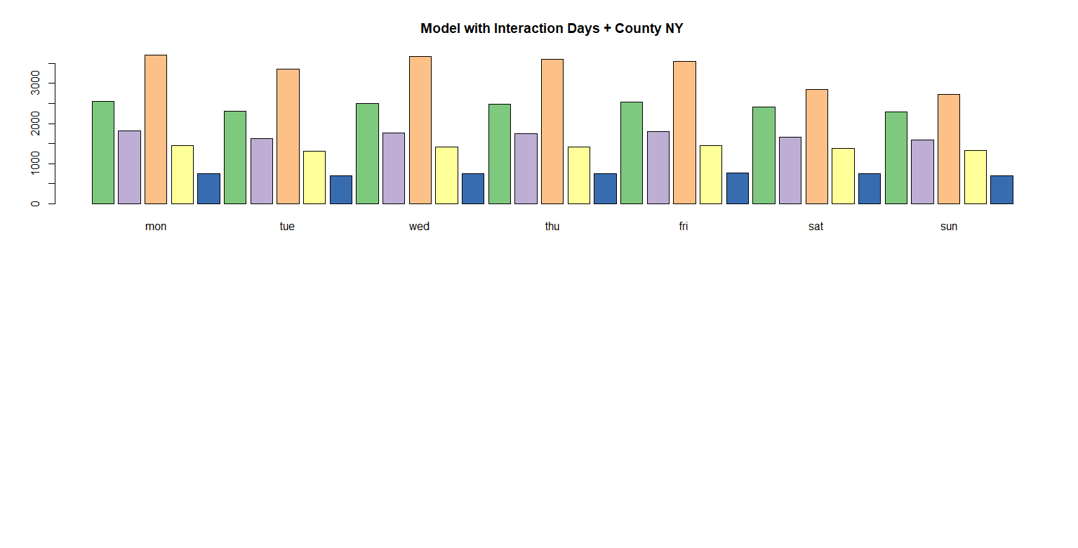
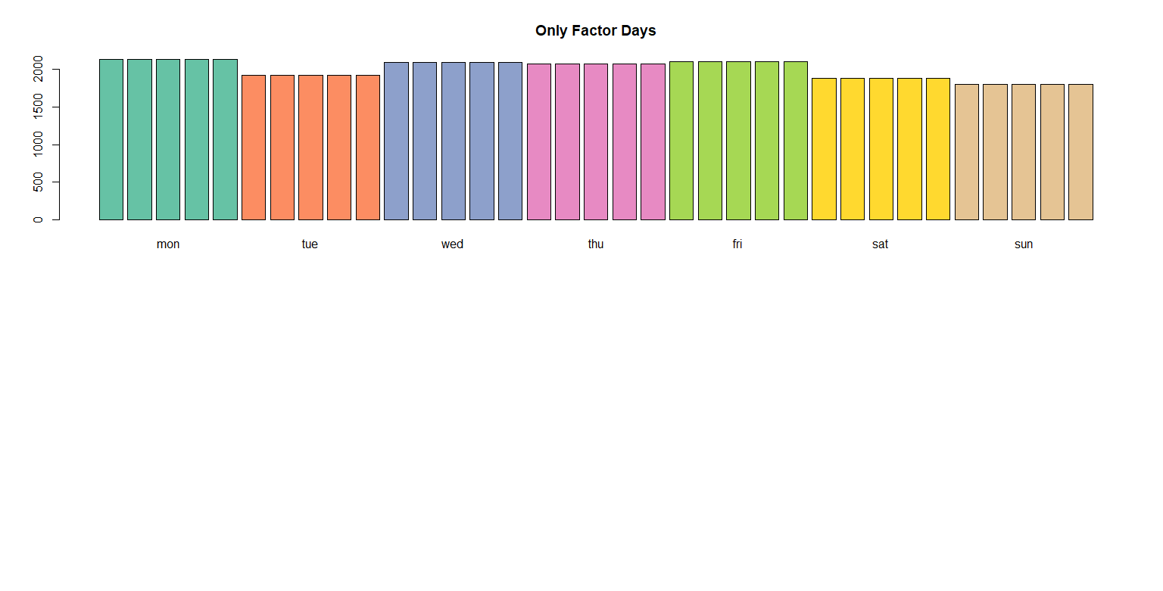
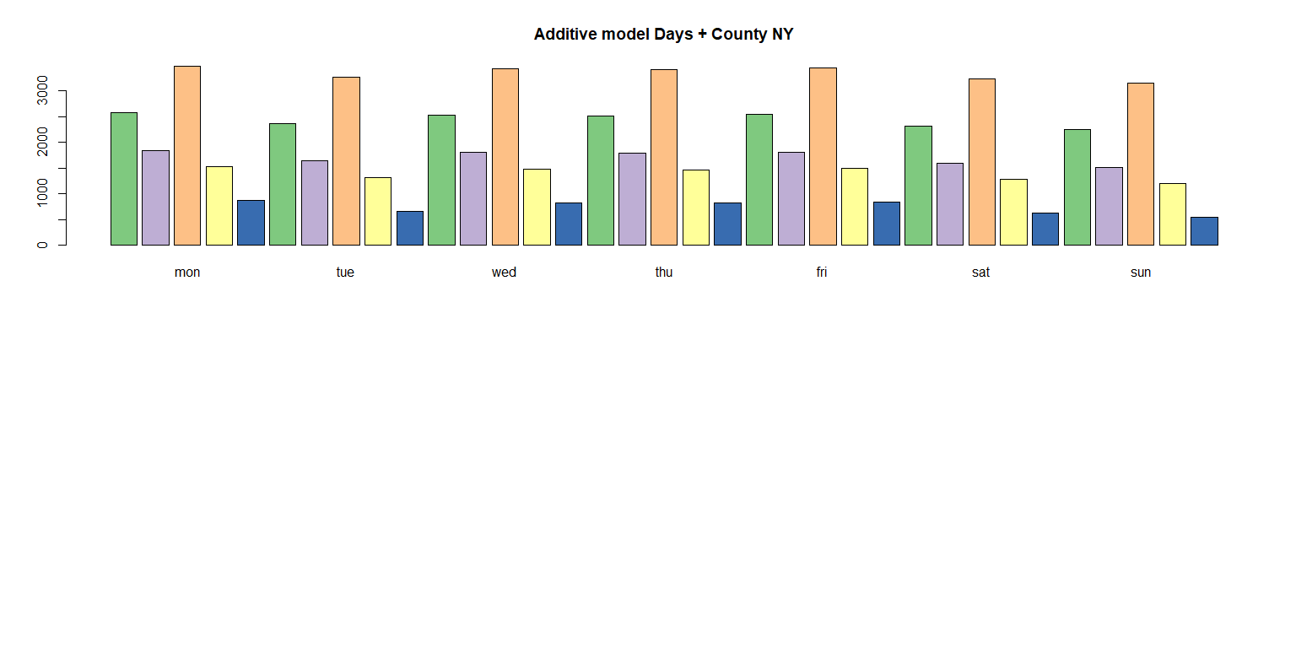
New York Counties
Variables : mean density of stops[1/km² ]
factor 1 → week day
factor 2 → NY county
Notes:
we discover that in the dataset there are different counties in the state of NY (5) as you can see in the video. we think that could be a good idea to focus our attention on the city of new york and then check if there are some correlation between the various counties

Slide 12
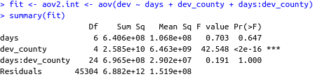


New York Counties
→ no interaction days ~ counties
→ no influence wrt days
→ factor county relevant
Notes:
we discover that in the dataset there are different counties in the state of NY (5) as you can see in the video. we think that could be a good idea to focus our attention on the city of new york and then check if there are some correlation between the various counties

Slide 13
OPENED QUESTIONS
How to consider CBGs: points or areas?
How to select features:
some are similar and maybe can be combined → PCA?
common behaviour between counties → clustering?

Slide 14
BIBLIOGRAPHY
https://docs.safegraph.com/v4.0/docs/neighborhood-patterns-2020
New York State - USA.com™
Thank you for the attention!
Babini Teresa, Lombardi Filippo, Rossetti Pietro, Rota Francesca

